Slide 1
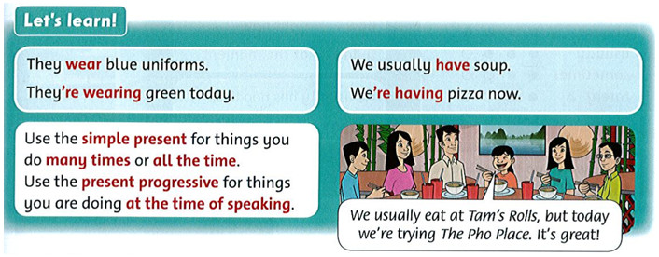
Friday , October 29th 2021 Unit 3 : The food here is great! Lesson 2
1. Listen to the story and repeat. Act.
2. Listen and repeat.
Click here to listen

Slide 2
Simple Present ( hiện tại đơn) always, often, usually, sometimes, never,

Slide 4
Script:
They wear blue uniforms.
They're wearing green today.
They usually have soup.
We're having pizza now.
Dịch:
Họ mặc đồng phục màu xanh nước biển.
Hôm nay họ đang mặc đồ màu xanh lá cây.
Họ thường xuyên có súp.
Bây giờ họ đang có pizza.

Slide 5
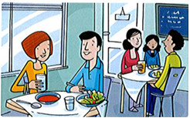
3. Read, circle, and say.
1. She drink / is drinking / drinks a glass of water now.
2. The family sit / is sitting / sits by the door today.
3. They usually sit/ are sitting / sits by the window.
4. He never have / is having / has soup for dinner.
5. She have / is having / has soup today.

